Slide 1
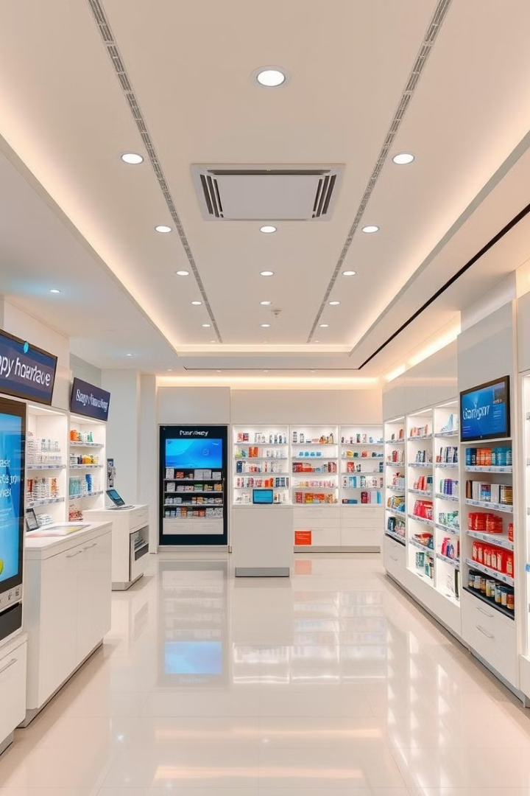

Pharmacy Management System
Our Pharmacy Management System revolutionizes pharmaceutical operations. It combines user authentication, inventory control, and sales tracking in a user-friendly interface. This comprehensive solution enhances efficiency and accuracy in pharmacy management.

Slide 2
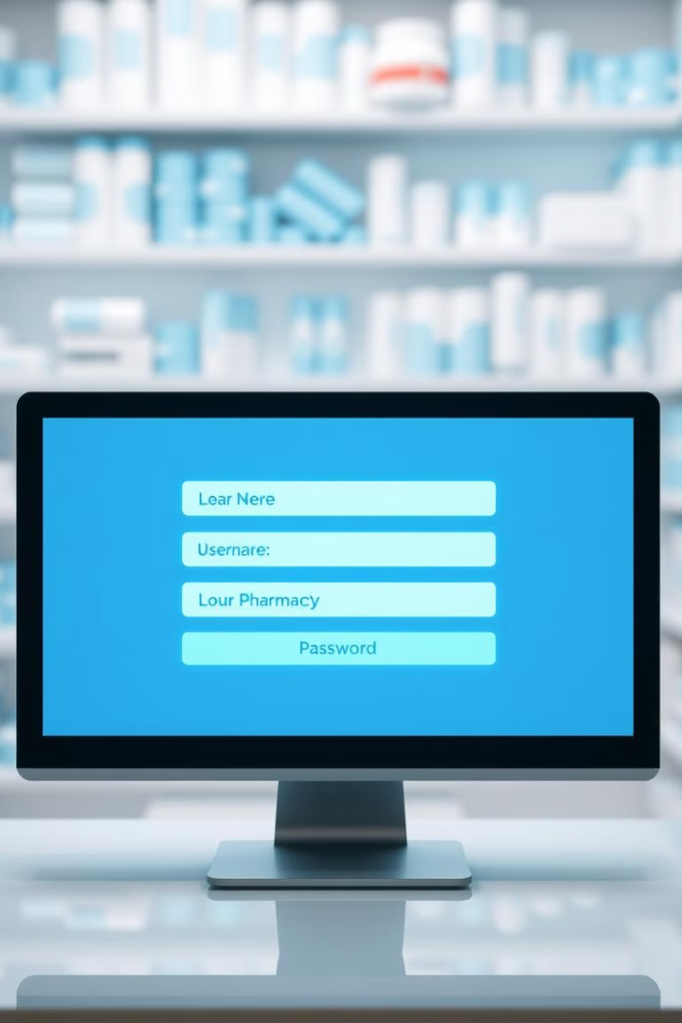
Secure User Authentication
Role-Based Access
Default Credentials
System provides distinct access levels for admin and staff roles. This ensures appropriate permissions and data security.
Pre-configured usernames and passwords enable quick setup. Customization options allow for personalized security measures.
Secure Login Process
Authentication system verifies user credentials. It protects sensitive pharmacy data from unauthorized access.

Slide 3

Comprehensive Inventory Management
1
Data Loading
Inventory class loads data from CSV file. This ensures up-to-date information on stock levels.
2
Item Properties
Each item has unique ID, name, quantity, and expiration date. These details enable precise inventory tracking.
3
Inventory Updates
System allows real-time updates to inventory. Changes are immediately reflected in the database.
4
New Item Addition
Users can easily add new items to inventory. This keeps the stock list current and comprehensive.

Slide 4
Efficient Sales Tracking
Sales Recording
Data Analysis
Financial Reporting
Each transaction is recorded in sales.csv. This creates a detailed log of all pharmacy sales.
Sales data enables trend analysis and forecasting. This information helps in inventory management and business strategy.
System generates financial reports from sales data. These reports provide insights into pharmacy performance.

Slide 5

Intuitive Graphical User Interface
1
Tkinter Framework
2
Themed Design
3
User-Friendly Layout
GUI built using Tkinter for robust functionality. This ensures a responsive and stable user interface.
TTKThemes enhance visual appeal of the interface. Custom themes can match pharmacy branding.
Intuitive design simplifies navigation and task completion. This reduces training time for new staff.

Slide 6




Automated Expiration Tracking
Date Monitoring
Alert Generation
Inventory Optimization
System automatically tracks expiration dates of all inventory items. This prevents dispensing of expired medications.
Alerts are created for approaching expiration dates. This allows timely restocking or removal of items.
Expiration tracking helps optimize inventory levels. It reduces waste and ensures fresh stock.

Slide 7
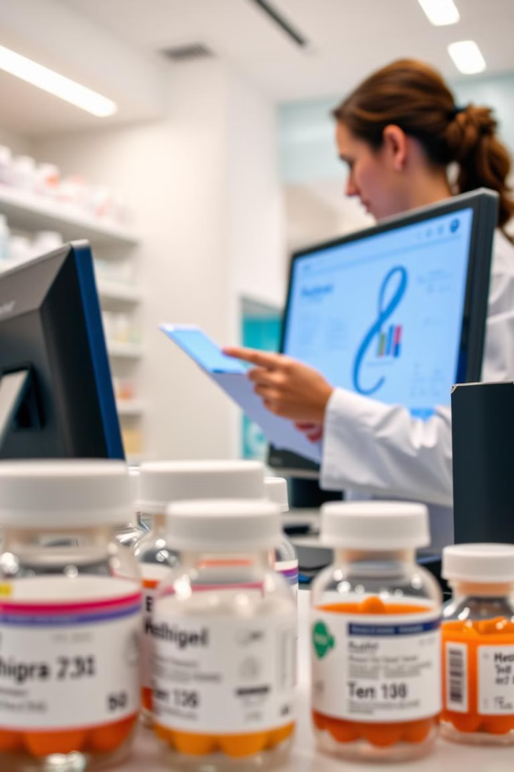
Prescription Management
Feature
Benefit
Digital Prescription Entry
Reduces errors in interpretation
Patient History Access
Ensures medication compatibility
Refill Tracking
Improves patient medication adherence
Insurance Verification
Streamlines billing process

Slide 8




Reporting and Analytics
Sales Reports
Generate detailed reports on daily, weekly, and monthly sales. Identify top-selling products and peak hours.
Inventory Analysis
Track stock levels, turnover rates, and reorder points. Optimize inventory for better cash flow.
Financial Performance
Monitor profit margins, expenses, and revenue trends. Make data-driven business decisions.

Slide 9

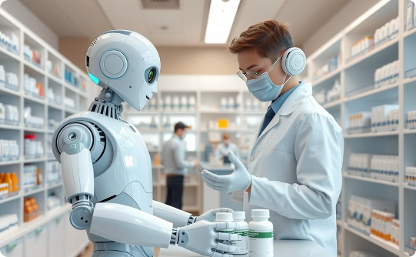

Future Enhancements
Mobile Integration
AI-Powered Assistance
Blockchain Integration
Develop mobile app for on-the-go inventory and sales management. Enable remote access for pharmacists and managers.
Implement AI for predictive analytics and automated restocking. Enhance decision-making with machine learning algorithms.
Utilize blockchain for secure, transparent drug traceability. Improve supply chain management and prevent counterfeit medications.

